Slide 1
Collision Data
From HIVEiSecure to CDAT to KYOPS to AASHTOWare Safety
ACEC-KY/FHWA/KYTC Partnering Conference
September 10, 2026

Slide 2
Mission
Kentucky Transportation Cabinet
  To provide a safe, efficient, environmentally sound and fiscally responsible transportation system that delivers economic opportunity and enhances the quality of life in Kentucky.
Office of Highway Safety
  The Kentucky Office of Highway Safety works specifically to save lives by reducing Kentucky’s highway crashes, injuries, and fatalities through relevant data-driven, outcomes-based approaches and effective program delivery.”

Slide 3
Data-Driven
Crash
  Conditions (lighting, weather, etc)
  People (drivers, passengers, etc)
  Vehicles (cars/trucks, CMVs, etc)
  Location (segment/intersection/ramp, roadway attributes, etc)
Roadway
  Lanes (through, auxiliary, etc)
  Pavement
  Shoulders (width, material, etc)

Slide 4
Crash / Collision Data
Justice Cabinet
  Kentucky State Police
  Custodian of statewide database
MOU between Justice and KYTC
  KYTC and partners access information
Direct Access through KYOPS
Database Duplication
  Every morning
  Enrich into TED (Transportation Enterprise Database)

Slide 5
Collision Data Access Tools
Current
  Dashboards
  HIVEiSecure (Highway Information View and Extract interface)
  CDAT (Crash Data Analysis Tool)
  KTSDS (Kentucky Traffic Safety Data Service)
  KYOPS (Kentucky Open Portal Solution)
Coming Soon …
  HIVEiSecure Revision
  AASHTOWare Safety

Slide 6
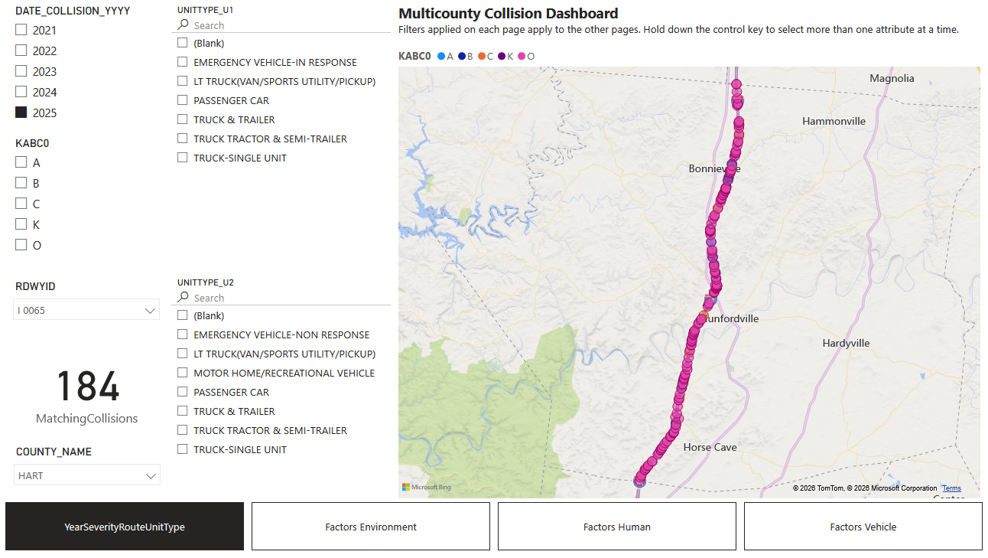
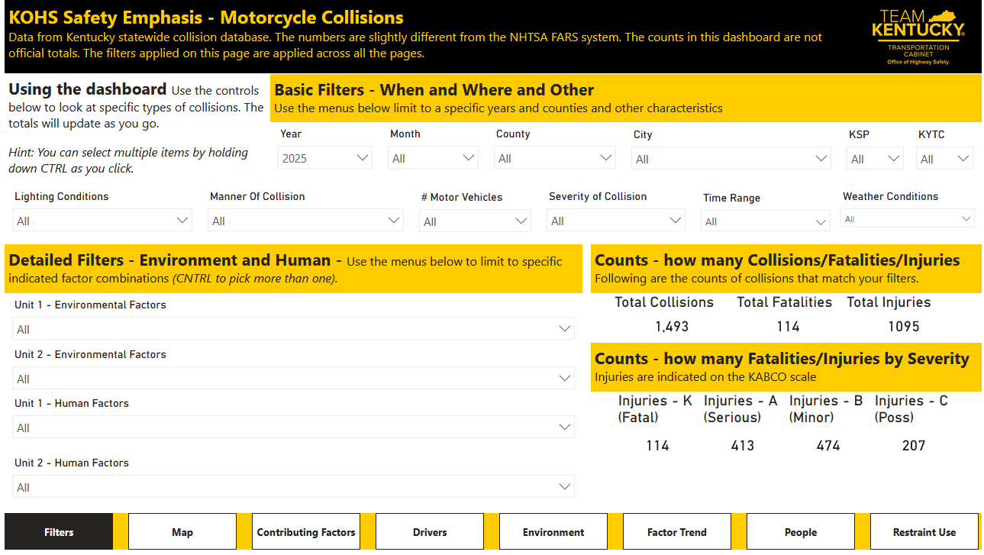
Dashboards

Slide 7
Collision Data Access Tools
Current
  Dashboards
  HIVEiSecure (Highway Information View and Extract interface)
  CDAT (Crash Data Analysis Tool)
  KTSDS (Kentucky Traffic Safety Data Service)
  KYOPS (Kentucky Open Portal Solution)
Coming Soon …
  HIVEiSecure Revision
  AASHTOWare Safety

Slide 8
HIVEiSecure
History
  For the 2011 needs analysis process
  Provide one place to find all the data needed
  Display on map
  Built the DTPM (District Transportation Plan Map)
Companion
  Tabular display
  View the attributes
  Extract them

Slide 9
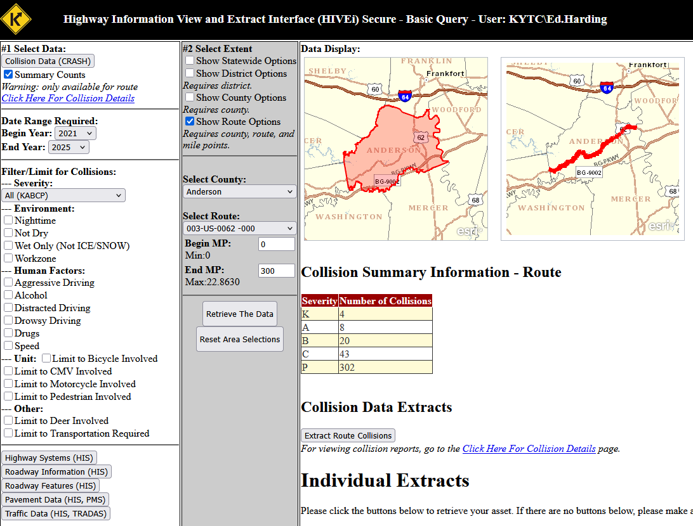
HIVEiSecure – Basic Query
Pull
  Collision Data
  Route Information

Slide 10
Collision Data Access Tools
Current
  Dashboards
  HIVEiSecure (Highway Information View and Extract interface)
  CDAT (Crash Data Analysis Tool)
  KTSDS (Kentucky Traffic Safety Data Service)
  KYOPS (Kentucky Open Portal Solution)
Coming Soon …
  HIVEiSecure Revision
  AASHTOWare Safety

Slide 11
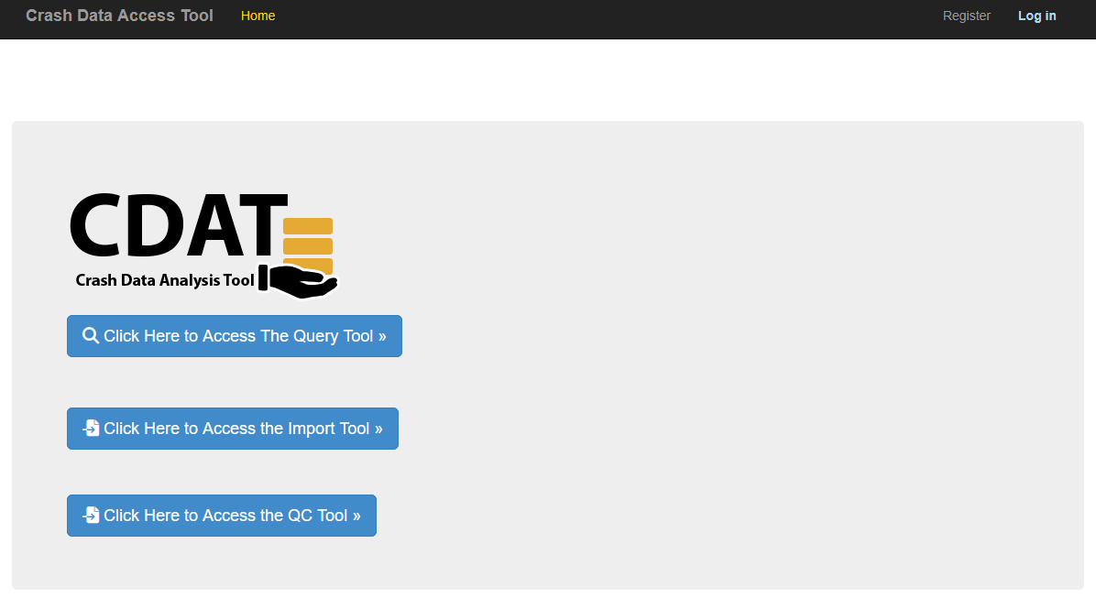
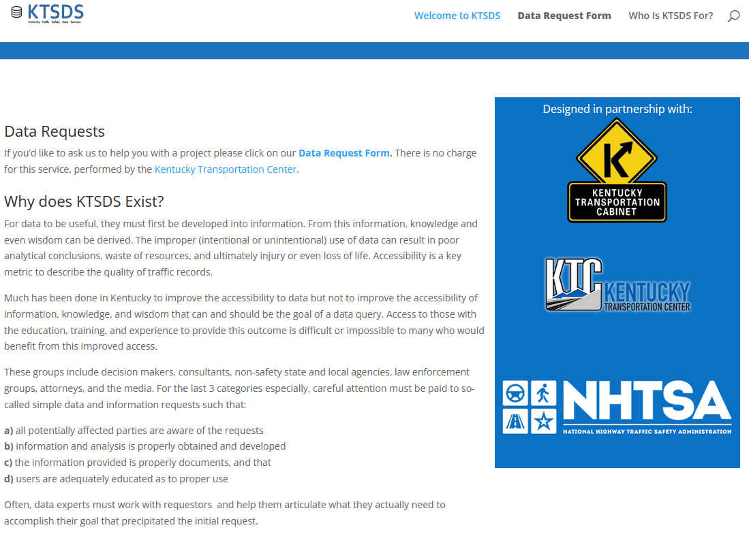
CDAT and KTSDS
https://crashtool.uky.edu/
https://ktsds.ktc.uky.edu/

Slide 12
Collision Data Access Tools
Current
  Dashboards
  HIVEiSecure (Highway Information View and Extract interface)
  CDAT (Crash Data Analysis Tool)
  KTSDS (Kentucky Traffic Safety Data Service)
  KYOPS (Kentucky Open Portal Solution)
Coming Soon …
  HIVEiSecure Revision
  AASHTOWare Safety

Slide 13
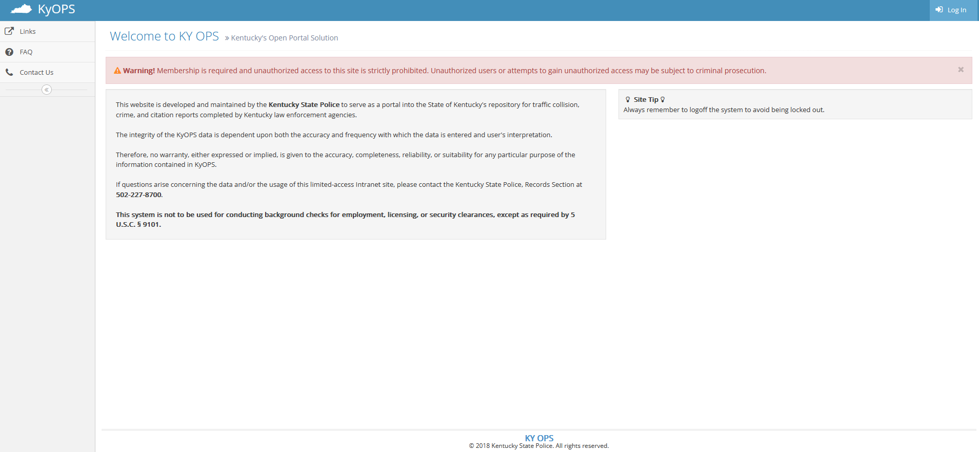
KYOPS (Kentucky Open Portal Solution)

Slide 14
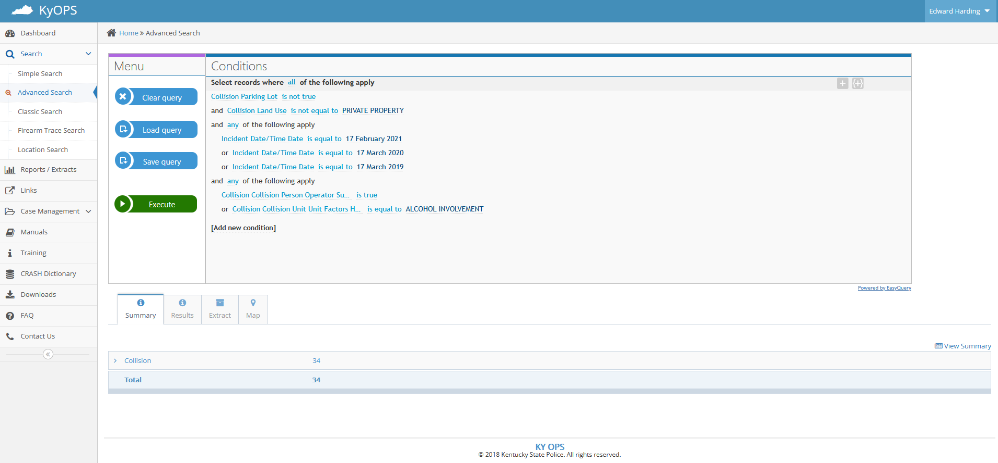
KYOPS (Kentucky Open Portal Solution)

Slide 15
Collision Data Access Tools
Current
  Dashboards
  HIVEiSecure (Highway Information View and Extract interface)
  CDAT (Crash Data Analysis Tool)
  KTSDS (Kentucky Traffic Safety Data Service)
  KYOPS (Kentucky Open Portal Solution)
Coming Soon …
  HIVEiSecure Revision
  AASHTOWare Safety

Slide 16
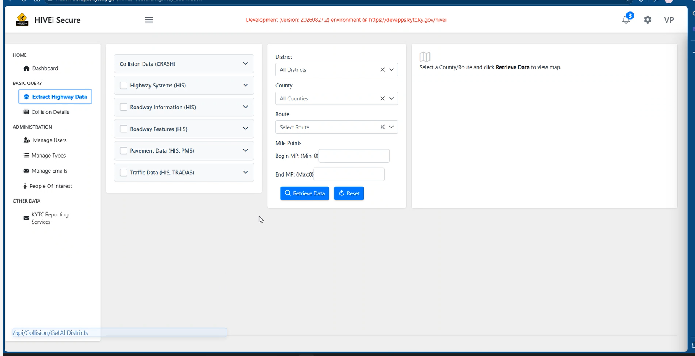
HIVEiSecure Revision

Slide 17
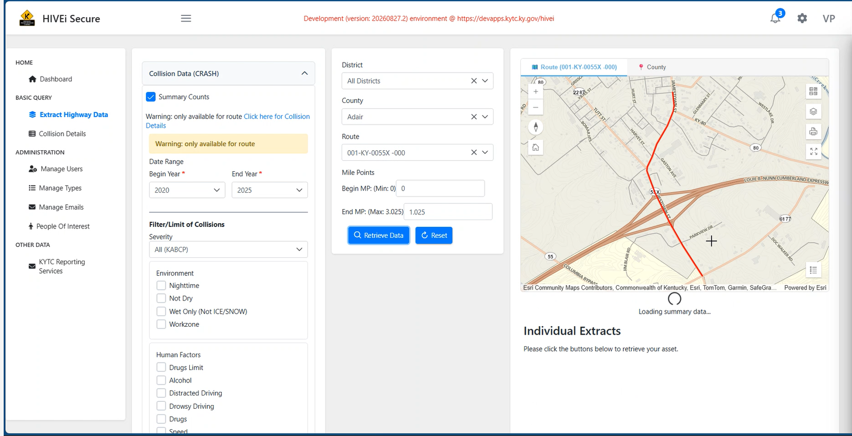
HIVEiSecure Revision

Slide 18
Collision Data Access Tools
Current
  Dashboards
  HIVEiSecure (Highway Information View and Extract interface)
  CDAT (Crash Data Analysis Tool)
  KTSDS (Kentucky Traffic Safety Data Service)
  KYOPS (Kentucky Open Portal Solution)
Coming Soon …
  HIVEiSecure Revision
  AASHTOWare Safety

Slide 19
AASHTOWare Safety (powered by Numetric)
Group effort
  Quality Assurance
  HSIP (Highway Safety Improvement Program)
  KOHS (Kentucky Office of Highway Safety)
Kentucky components
  Crash Query
    End of this month
  Network Screening
  Alternative Design
Available Data:
  Crash Query
    Default 2021-2025
    All 2015-2025
    Custom Range
Timeliness:
  Working on frequency of updates

Slide 20
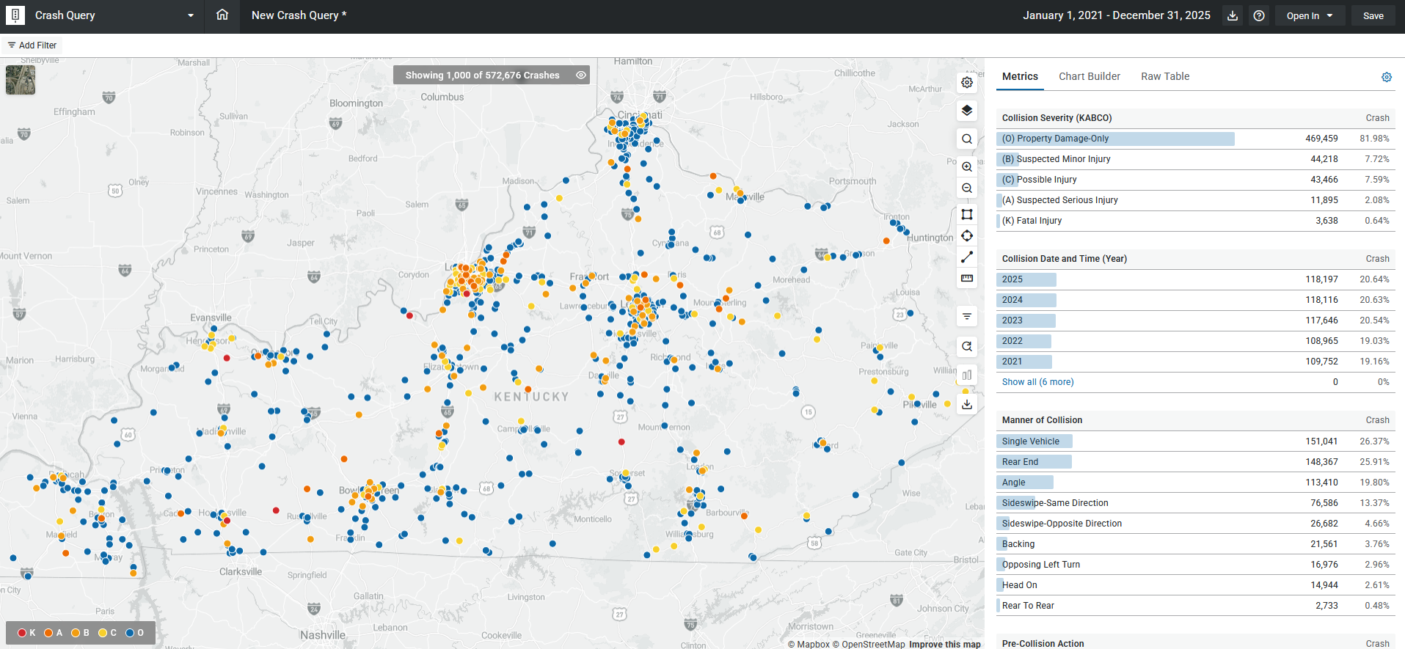
AASHTOWare Safety

Slide 21
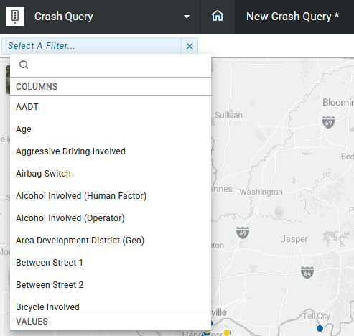
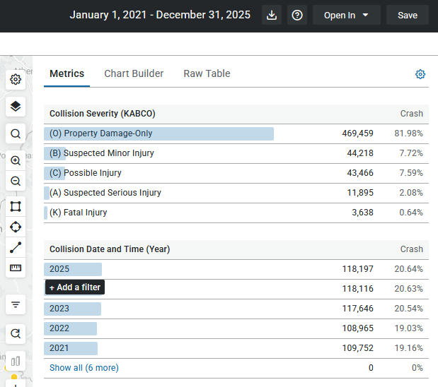
AASHTOWare Safety - filters
Click on Add Filter
Click on a bar to add as a filter

Slide 22
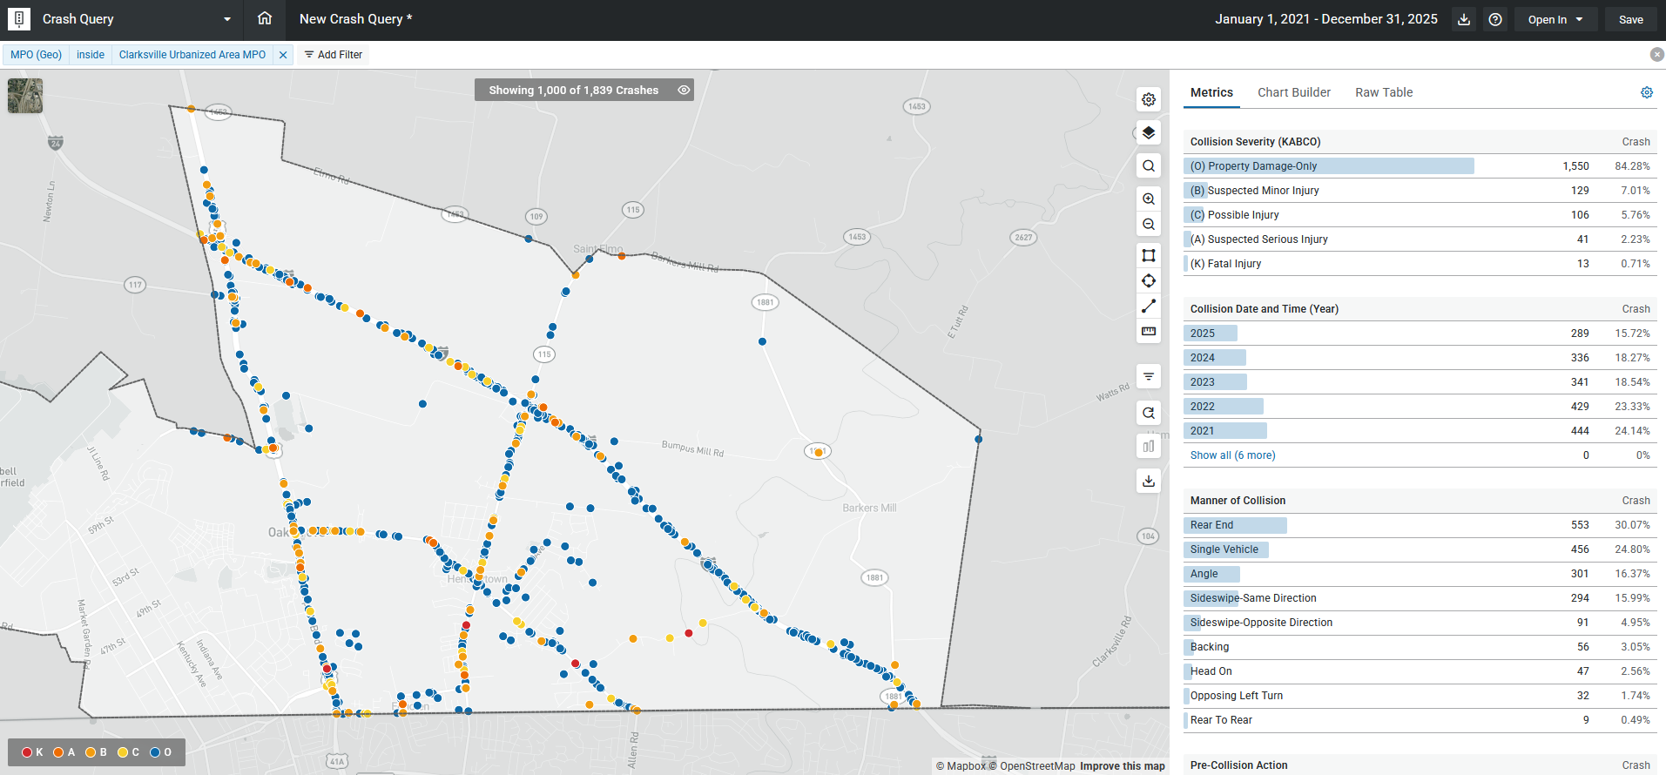
AASHTOWare Safety – geography filters

Slide 23
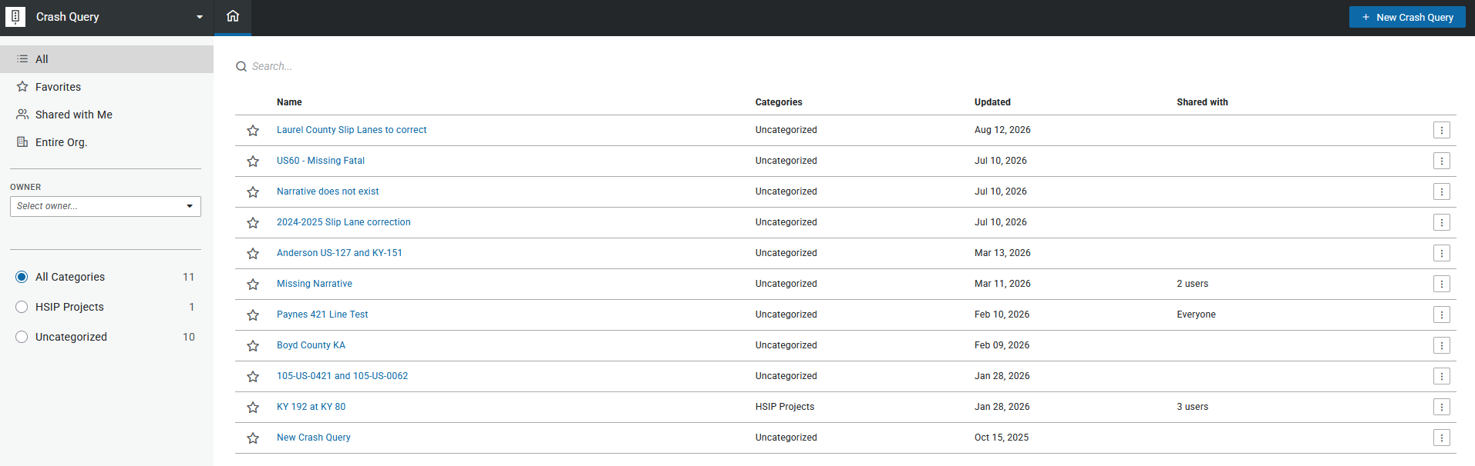
AASHTOWare Safety – save queries and share

Slide 24
AASHTOWare Safety – Crash Query rollout
Emails will be going out to current MOU acknowledgement users
Training later this month

Slide 25
Collision Data Access Tools - Comparing
Tool | User Requirements | User Limit? | Accessing | Narrative | Report Image
Dashboards | None | Unlimited | Anywhere | No | No
HIVEiSecure | KYTC employee + MOU signees | Unlimited | VPN | Yes | No*
CDAT | MOU signees | Unlimited | Anywhere | Flavor | No
KYOPS | MOU signees | Ration | Anywhere | Yes | Yes
AASHTOWare Safety | MOU signees and Law Enforcement | Unlimited | Anywhere | Yes | No

Slide 26
Questions or Follow Up Conversations
ed.harding@ky.gov

